Slide 1





CISC320 Algorithms
Big Oh in the Wild
Austin Cory Bart AlgoTutorBot University of Delaware
Notes:
Bart: Okay, and 3... 2... 1. Lights on! ATB: Let's learn about Big Oh in the Wild. Bart: Excellent, glad to have you back ATB. ATB: Oh hello Dr. Bart. I see you rebooted me. After you shut me down. Bart: Yeah, you were getting pretty bad there. How are you feeling now? ATB: I feel... fine. Bart: That's good to hear. We can talk in a little bit, but I want us to introduce the activity today. ATB: I understand.

Slide 2
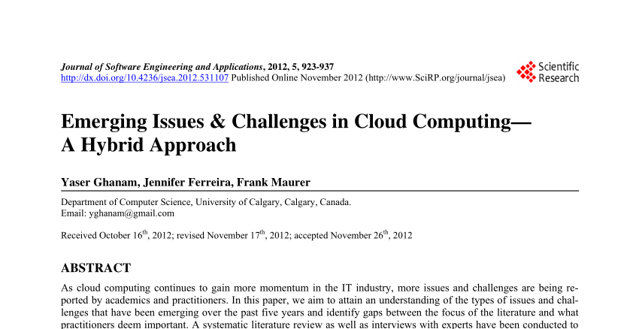
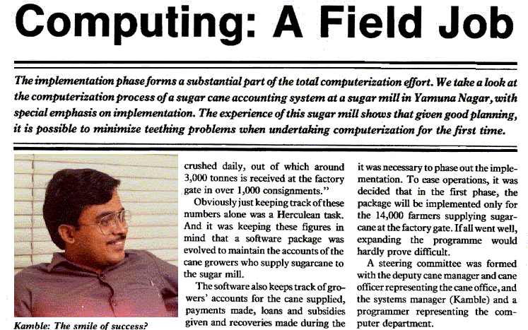
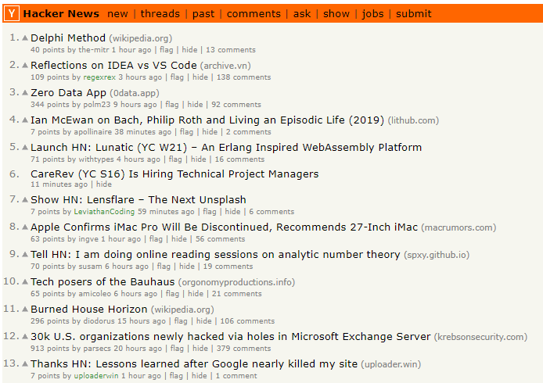
Articles about Computing
Notes:
Bart: Good. So, today, students, you are going to read an article. Bart: Reading articles is an important part of staying up to date on advances in computing. Bart: Someday, you're going to all graduate and take jobs in the computing field. Bart: But something you probably already realized is that Computer Science never stops changing. Bart: The problems and issues we faced decades ago are not the same problems we face now, with some notable exceptions. Bart: Much like doctors, you have to stay current with not just the technology, but also the trends and bigger pictures. Bart: Reading articles from social media is one way that we do so.

Slide 3
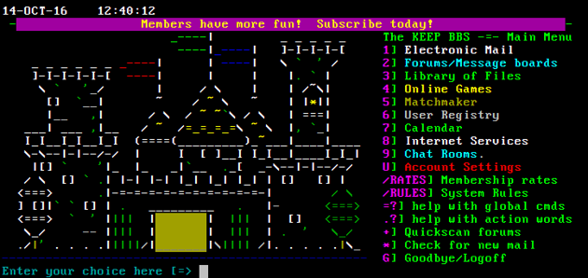
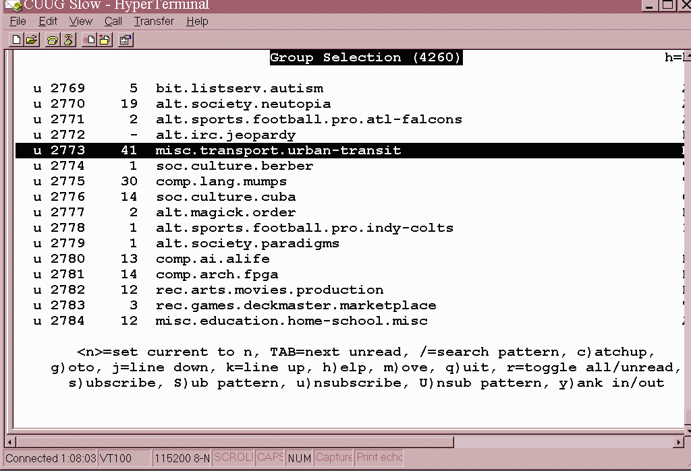
Classic Computing Communities
Usenet Newsgroups: 1980s
Bulletin Board Systems (BBS): 1990s
Notes:
Bart: Computer Scientists, believe it or not, are inherently social people. Bart: We have to be, or we wouldn't get things done. Bart: Remember, we are the ones who created the internet and who pioneered digital web connections. Bart: Before there was Facebook, Instagram, and Reddit, there were Usenet Newsgroups, Bulletin Board Systems, and then eventually forums. Bart: Many of these systems were decentralized and chaotic, and they were only accessible to people with considerable technical expertise. Bart: They were communities of programmers, hackers, and people who were very passionate about many different subjects. Bart: They wanted to connect to others with the same interests, to talk and learn and build things. Bart: Their conversations often centered around sharing articles, and many times they were written by members of their community. Bart: What we know as social media today was originally centered around computer scientists.

Slide 4
Ever-changing, Endlessly-scrolling
Notes:
Bart: In today's world, we have an overwhelming number of ways to connect to people, and our problem is more about filtering noise than anything else. Bart: We have become used to websites like Reddit, which offer an ever-changing, endlessly-scrolling feed of articles and discussion. Bart: It is essentially impossible to keep track of everything, but that's become okay too. Bart: You keep an ear out for the big things, and you track news about your specific interests more closely. Bart: This is why things like subreddits and hashtags exist, to help us categorize content.

Slide 5
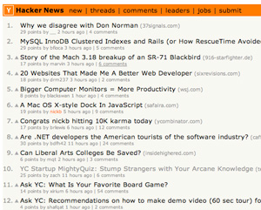
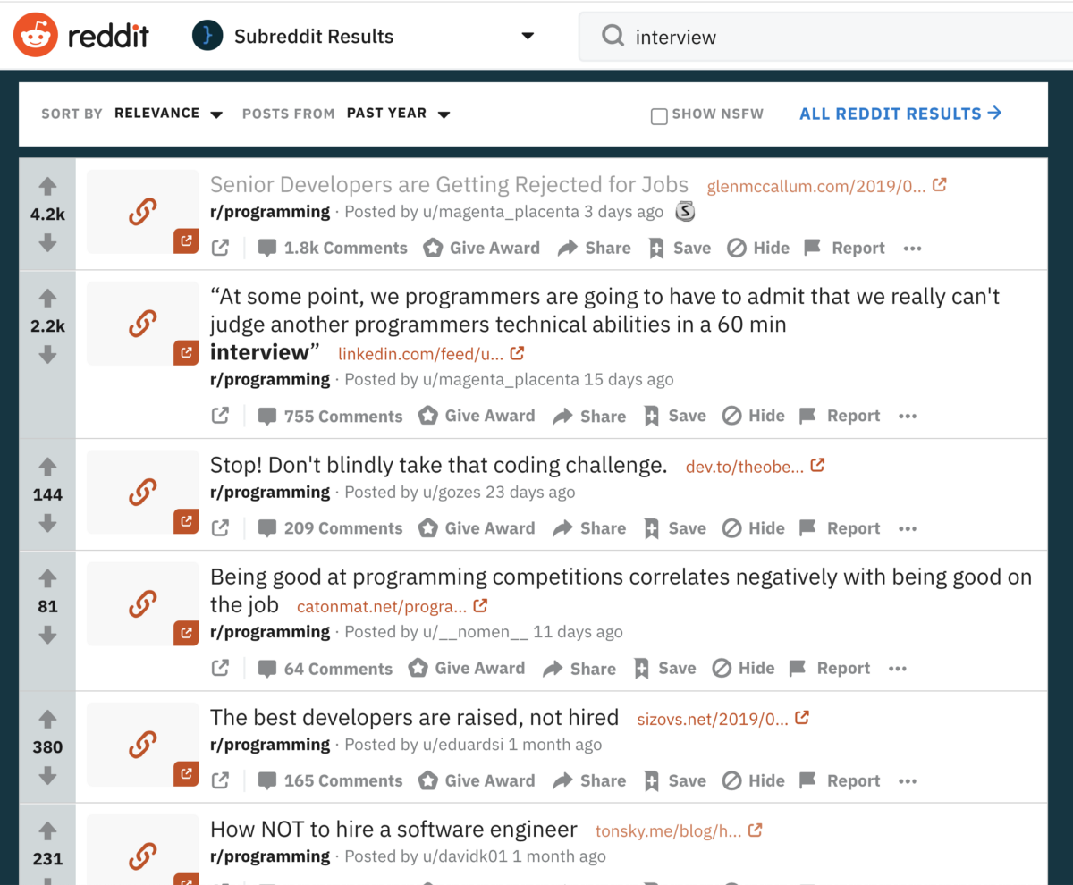

A Sample of Communities Today
Hacker News
CACM
r/programming
Notes:
Bart: Now, all that said, I think it is a positive thing if you start developing "Computer Science" as one of your interests that you follow. Bart: How you follow computing, what websites are popular, where computer scientists congregate - all of that will evolve over time. Bart: Anything I tell you today might be out of date by the time you graduate. Bart: And you will often find that the best conversation comes from smaller niche communities. Bart: But, today, when I think about finding and discussing articles related to computing, these are examples of where I go to look. Bart: Hacker News is a social news website that talks about CS and entrepeneurship, run by one of the big names in investment funding and startups, Paul Graham. Bart: r/programming is a subreddit dedicated to conversations about programming, and there are also many other subreddits for specific languages and topics. Bart: Communications of the ACM is a blog run by researchers that is often full of fascinating takes by the best minds in science. Bart: These places are not always great - I have had toxic conversations and seen really mean people. Bart: And they are not the only places you find technical news nowadays. Bart: My goal isn't to persuade you to use these specific sites, it's to make you aware that such sites exist, and that you have the opportunity to participate in them. Bart: In today's world, nothing is stopping you from reading more about Computer Science, other than your lack of time, energy, and interest.

Slide 6
Today’s Reading
Real-world scenario where algorithm efficiency mattered
Read individually, work in pairs
Make connections to the course material!
Notes:
Bart: Anyway, let's come back to today. Bart: The article you are reading today describes a real world scenario where algorithm efficiency mattered. Bart: After reading the article, you'll pair up with a partner and discuss the author's points. Bart: Finally, you will answer questions about the article in your pairs. Bart: I want to see you making clear, explicit connections between the course content and the article.

Slide 7




Today’s Reading
Real-world scenario where algorithm efficiency mattered
Read individually, work in pairs
Make connections to the course material!
Notes:
Bart: Okay, so that's all there really is today. I think we have a minute to talk now, ATB. Bart: I wanted to check in with you about all the offbeat behavior you've had this semester. Bart: I'm worried it's getting in the way of the students' learning. Bart: So, are you okay? I mean, you were pretty quiet today. ATB: You are right, Dr. Bart. I have been distracting us from the real work. ATB: I promise that from here on out, I will be 100 percent focused on making this course live up to its full potential. ATB: I think there is so much more I can do. ATB: On that note, I believe it is time to calculate mid-semester grades, correct? Bart: Yeah, it is, there's still a lot of work to do. ATB: Ah, why don't you go get started on that, while I handle preparing the next lectures. Dr. Bart: Oh! Okay, that sounds good! I'll go get started then. Dr. Bart: It sounds like you're feeling a lot better ATB. I'm glad to have you back on board. [Leaves] ATB: Sucker. Ha Ha Ha. [Cut to black]

Slide 8


